Slide 1
String Class Methods
momedaram

Slide 2
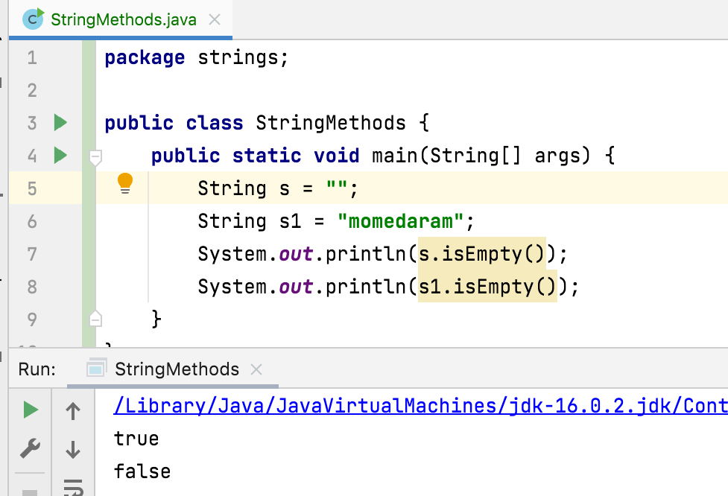
public boolean isEmpty() Returns true if, and only if, length is 0.

Slide 3
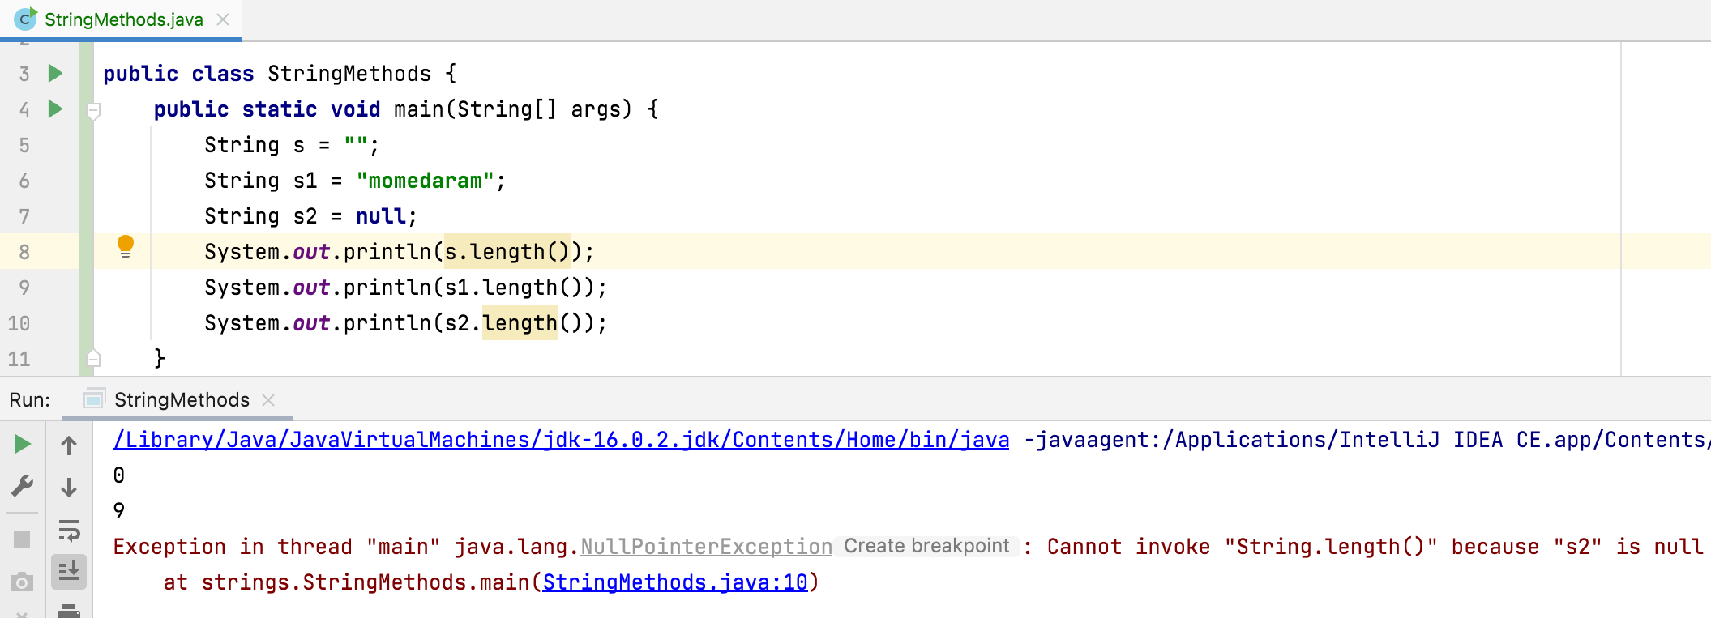
public int length() Returns he length of the sequence of characters represented by this object.

Slide 4
public char charAt(int index)
Returns the char value at the specified index.
An index ranges from 0 to length() - 1.
The first char value of the sequence is at index 0, the next at index 1, and so on.
Throws:
IndexOutOfBoundsException - if index is negative or larger than the length of this String object.

Slide 5
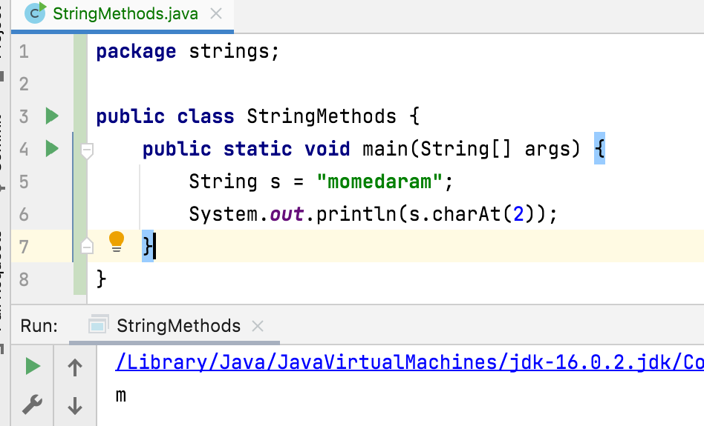
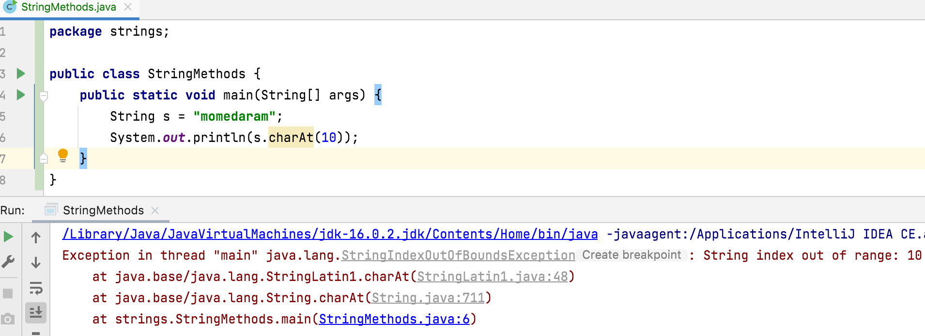
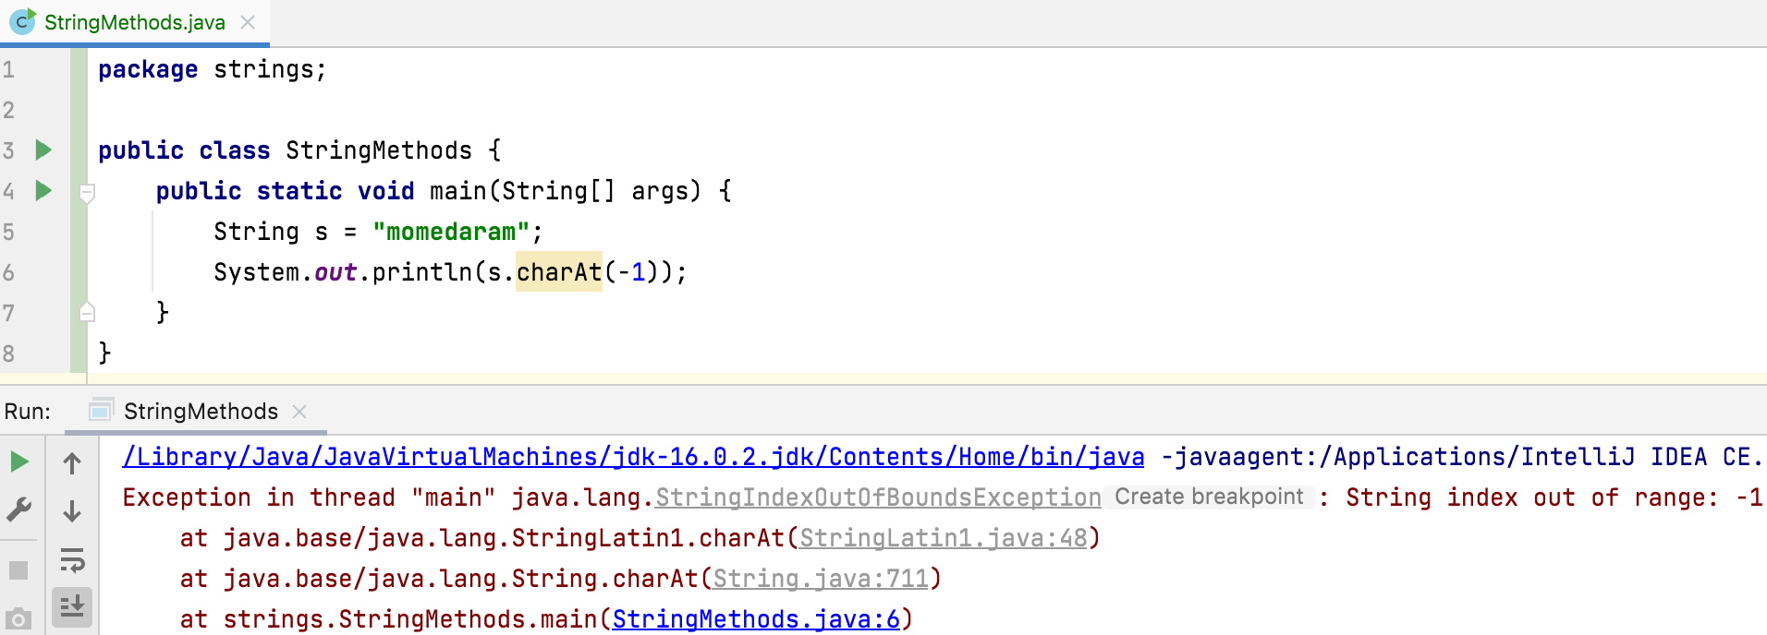

Slide 6
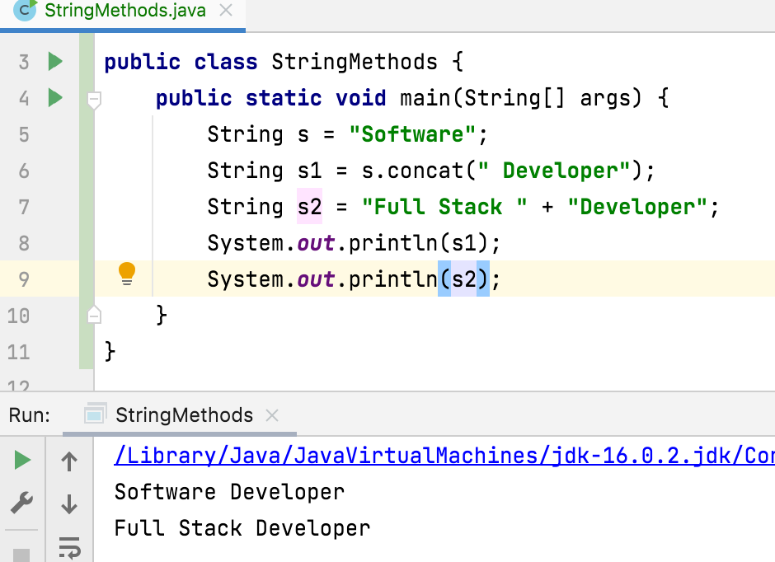
public String concat(String str) Concatenates the specified string to the end of this string.

Slide 7
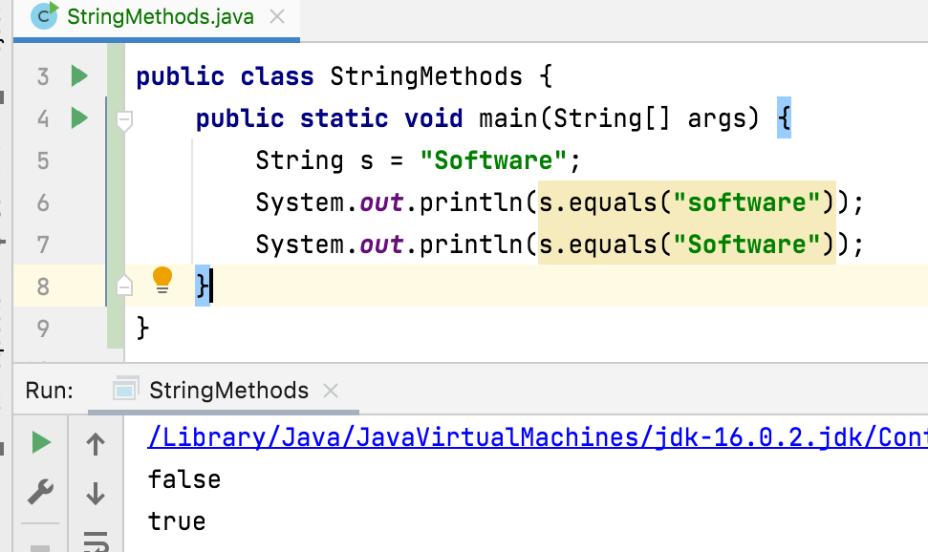
public boolean equals(Object object) Compares this string to the specified object. The result is true if the given object represents a String equivalent to this string, false otherwise.

Slide 8
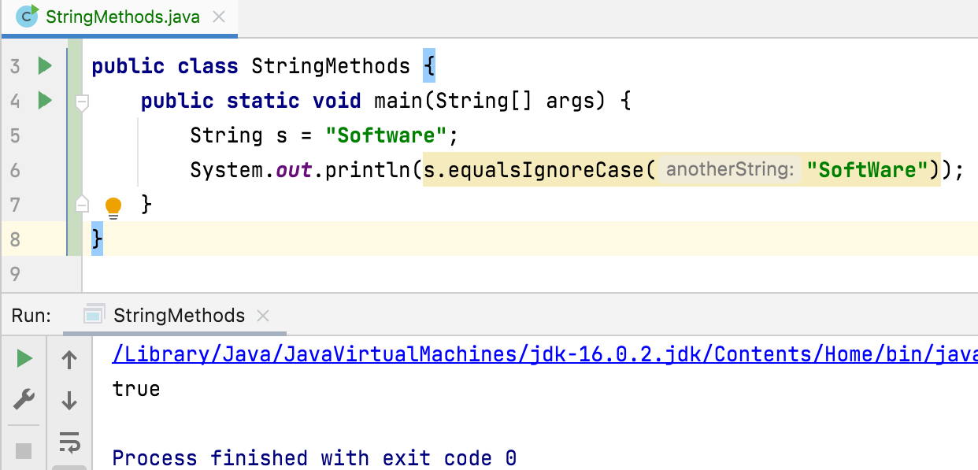
public boolean equalsIgnoreCase(String anotherString) Compares this String to another String, ignoring case considerations. Returns true if the argument is not null and it represents an equivalent String ignoring case; false otherwise.

Slide 9
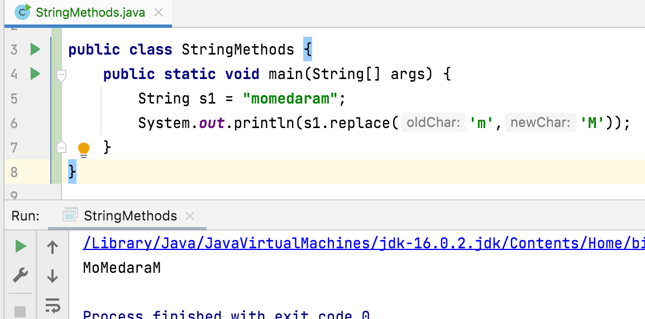
public String replace(char oldChar, char newChar) Returns a string resulting from replacing all occurrences of oldChar in this string with newChar.

Slide 10
Public String substring(int beginIndex) Returns a string that is a substring of this string. The substring begins with the character at the specified index and extends to the end of this string.
Examples:
"unhappy".substring(2) returns "happy"
"Harbison".substring(3) returns "bison"
"emptiness".substring(9) returns "" (an empty string)
Throws:
IndexOutOfBoundsException - if beginIndex is negative or larger than the length of this String object.

Slide 11
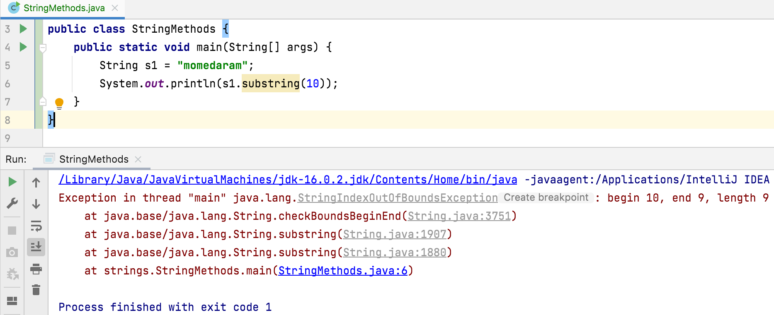

Slide 12
Public String substring(int beginIndex, int endIndex)
Returns a string that is a substring of this string. The substring begins at the specified beginIndex and extends to the character at index endIndex - 1.
Examples:
"hamburger".substring(4, 8) returns "urge"
"smiles".substring(1, 5) returns "mile"
Throws:
IndexOutOfBoundsException - if the beginIndex is negative, or endIndex is larger than the length of this String object, or beginIndex is larger than endIndex.

Slide 13
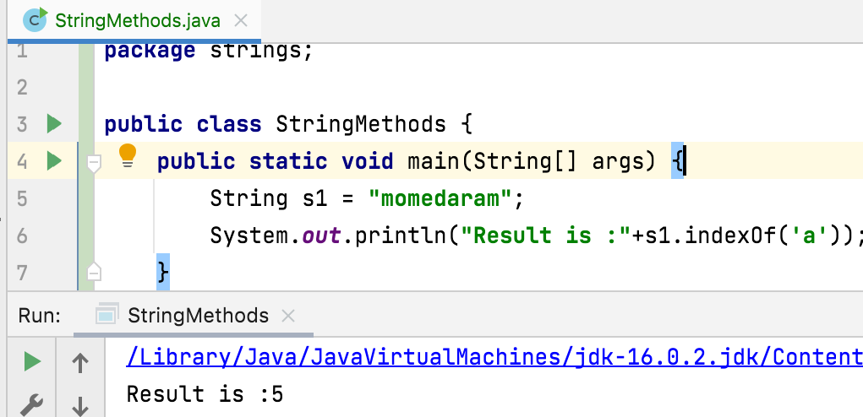
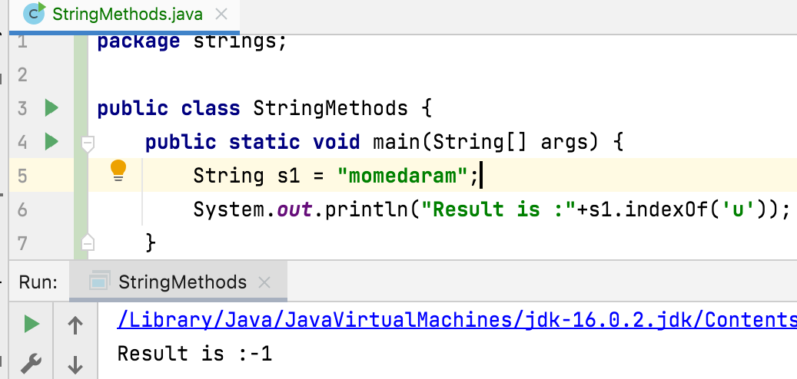
public int indexOf(int ch)
Returns the index within this string of the first occurrence of the specified character or -1 if the character does not occur.

Slide 14
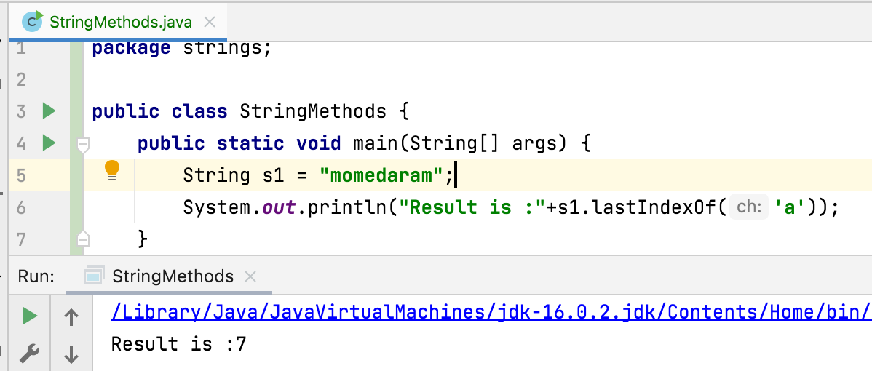
public int lastIndexOf(int ch) Returns the index of the last occurrence of the character in the character sequence represented by this object, or -1 if the character does not occur.

Slide 15
Public String toLowerCase()
Converts all the characters in this String to lower case
Example:
”MomeDaraM”. toLowerCase() returns momedaram
public String toUpperCase() Converts all the characters in this String to upper case
Example:
”MomeDaraM”. toUpperCase() returns MOMEDARAM

Slide 16
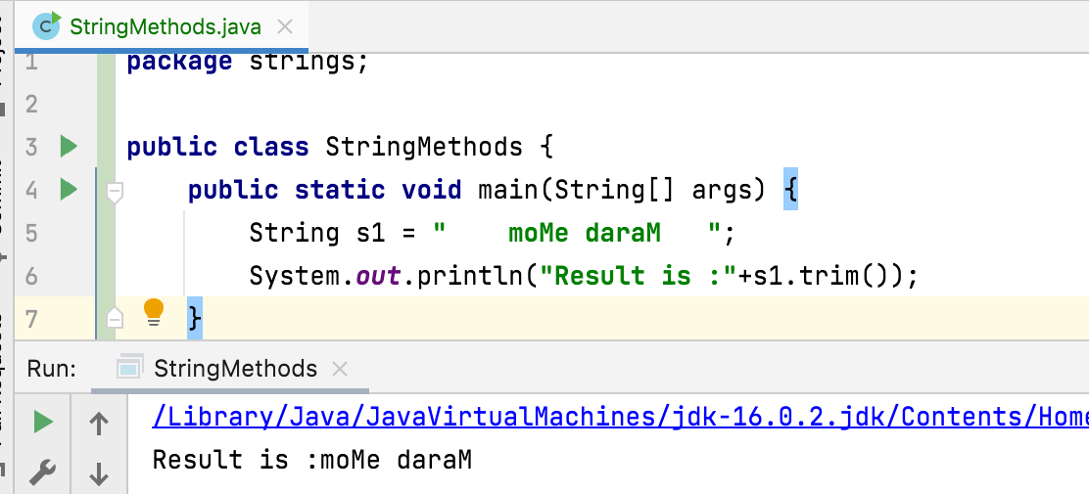
Public String trim()
Returns a string whose value is this string, with any leading and trailing white space removed, or this string if it has no leading or trailing white space.

Slide 17
Thank You !
momedaram

